Slide 1
Git Tutorial
Kristof Werling
April 2022

Slide 2
What is this training about
Focus is on Git commands as used from the command line
There are many different UI-clients available. By knowing the command line it will be easy to use anyone of them.

Slide 3
Installation

Slide 4
How to install Git locally on your computer
Browse to: https://git-scm.com/downloads
Follow the instructions for your OS
Make sure that the GIT commands can be used from the command line

Slide 5
Set up

Slide 6
What to configure with a newly installed Git client
There are two configuration steps absolutely necessary:
Configuration of the user name
Configuration of the user e-mail address
If solely working with the command line configuring the editor to use is also beneficial

Slide 7
User name and e-mail address
User name git config --global user.name “<<Real name of user>>“
E-Mail address git config --global user.email “somebody@computer.com“
Editor git config –global core.editor “code --wait“

Slide 8
Local, global, system
There are three levels on which the configuration can be made: This means, that one can use one e-mail address on the user level, but another one in one specific repository.
Level
system | Valid for all of the computer
global | Valid for the User
local | Valid for the repository

Slide 9
Command Line Commands

Slide 10
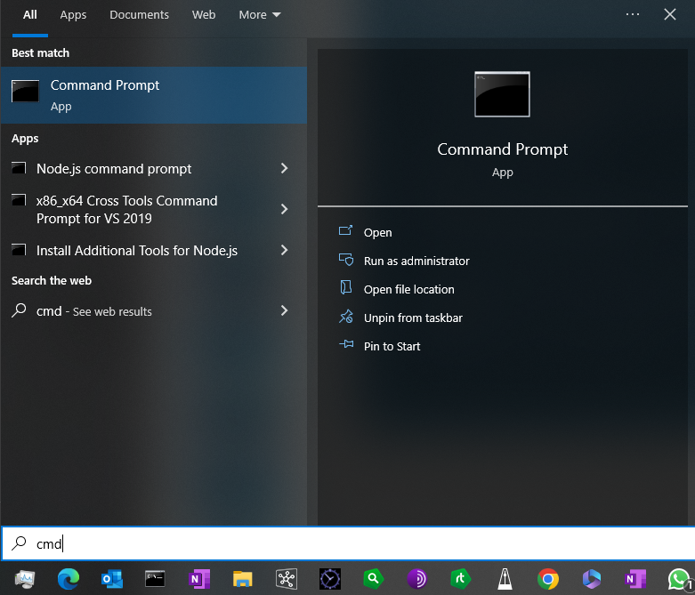
Open Console (Command Prompt)
Click on he windows Ican in he task bar to open the menu
Start typing the letters „cmd“ (stand for command.
When you see the screen at the right open the „Command Promt“ Application

Slide 11
DOS Commands for managing directories
DOS Command | Explanation
cd <directory name> | Change Directory: Go from the actual directory to the <directory name>
md <directory name> or mkdir <directory name> | Make Directory: Create a new directory
rd <directory name> or rmdir <directory name> | Remove Directory: Delete a directory. The directory must be empty.
ren <old directory name> <new directory name> | Rename a direcrtory.

Slide 12
DOS Text-Wildcards
Wildcard character | Explanation
* | Stands for zero or more characters.
? | Stands for exactly one character

Slide 13
Initialize a local repository

Slide 14
Create a local repository
To create a local repository one needs to run the following command in a directory: git init
During creation Git creates a (hidden) directory by the name of “.git “
Now you have an an empty repository

Slide 15
Repositories in Git

Slide 16
Relationship between repositories
Each user has a full local copy of the repository they work with
There is no special repository, like a master or central repository
Often, the remote repository (on GitHub) is declared to be the master every user is syncing with
If repositories are synced then all of them hold the same information

Slide 17

Relationship between repositories
Usually it works like this:
If all three repositories are synced then they contain the same information – all of the history of the repository
The remote repository is considered to be the Master by agreement. In theory, any other repository could be in that role, too
User A and User B will sync with and from the remote repository and not have any internaction beween them directly.
Repository Remote Github
Repository Local User A
//
Repository Local User B

Slide 18
Exercises with local repositories

Slide 19
Preparation
Requirements for the exercises
Have Git installed on your computer in the way that it can be used from the command line
Have your name and e-mail address configured, preferably on the global level.
Create a directory named “TestRep01“ any location you like (and have write access to)
Go into the directory and initialize a git repository.
Repository Local TestRep01

Slide 20
Preparation
Create a file
In the TestRep01 directory:
Create a text file with the ending of the name t1.txt
Write the following text into the file: This is the initial text I am going to check into the Git repository
Repository Local TestRep01

Slide 21
Committing a file to the repository
Steps to take to commit content to a repository
First the modified, added, or deleted files need to be added to the Staging area. This can be done multiple times, if needed As long as the files are still in the Staging area they can be removed from there if wished.
If satisfied the files in the Staging area can be committed into the repository.
Repository Local TestRep01

Slide 22
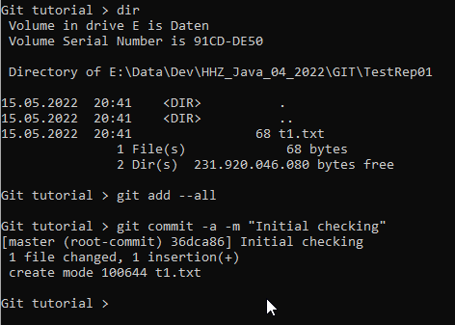
Committing a file to the repository
Commands to commit content to a repository
Adding files into Staging: git add –all (There are more specific options, but we will go with –all for the time being)
Finally commit the files in Staging into the repository: git commit –a –m “<<Comment>>“

Slide 23
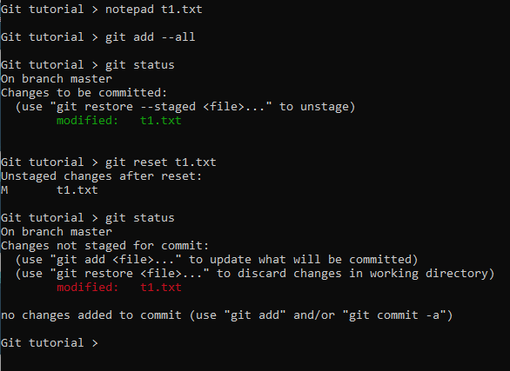


Committing a file to the repository
Commands to commit content to a repository
If ever a files was added to Staging and schould not be contained in the commit use the git reset command: git reset <<file name>>
Git status helps to understand what Staging looks like and what will be committed
CAREFUL: git restore eliminates the changes in the file and restores the version of it in the repository

Slide 24
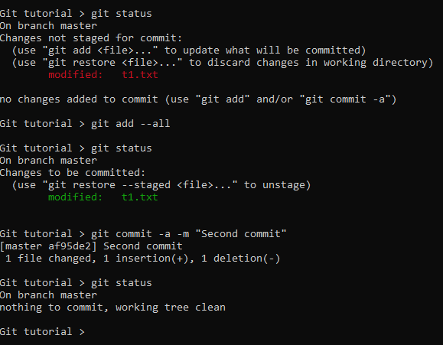
Committing a file to the repository
Commands to commit content to a repository
Modify t1.txt: Change the word initial to modified.
Run git status
Run git add –all
Run git status
Run git commit
Run git status

Slide 25
Committing a file to the repository
Committing content
Committing happens in 2 phases
As long as the content is in staging, then it can be taken from the commit
If changes to a local file should be reverted then the last committed version can be restored
Working directory
add
refresh
Staging area
restore
commit
Repository

Slide 26
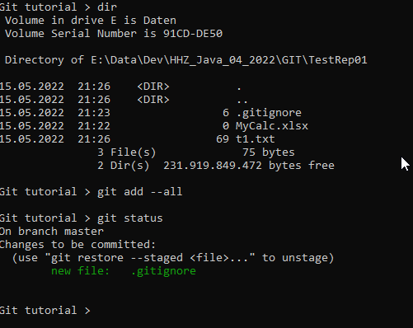
Committing a file to the repository
Preventing the commit of files -- .gitignore
The .gitignore file in the working directory allows for specifying the files, which never should be checked in ( such as the class files resulting from the java source files)
Create a .gitignore file with this content: *.xls*
Create an Excel file in the working directory
Run git add and then git status

Slide 27
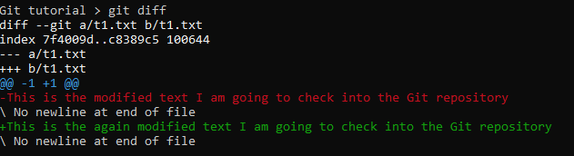
Committing a file to the repository
What changed?
How to see what was changed between the files in the working directory and the repository? Git diff
Modify the text in t1.txt.
Run git diff

Slide 28
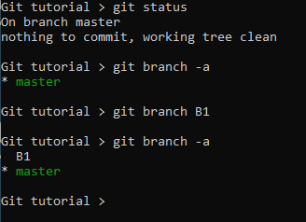
Working with branches
Create a branch and switch to it
To create a brach of the actual repository use git branch <<name of branch>>
Run git branch –a
Create a branch called B1
Run git branch -a

Slide 29
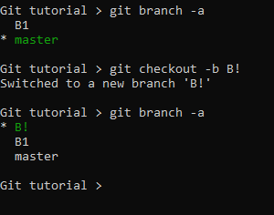
Working with branches
Create a branch and switch to it
In order to switch to branch B1 use the git checkout command: git checkout –b <<branch name>>
Run git branch –a
Run git checkout –b B1
Run git branch -a

Slide 30
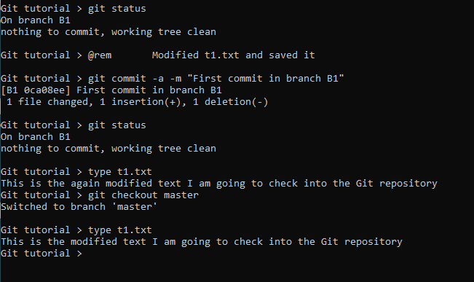
Working with branches
Working in a branch
Make sure yóu are in branch B1
Modify the t1.txt file and save it
Commit the changes to the repository
Run git status
Change to the master branch
Check out the content of t1.txt

Slide 31
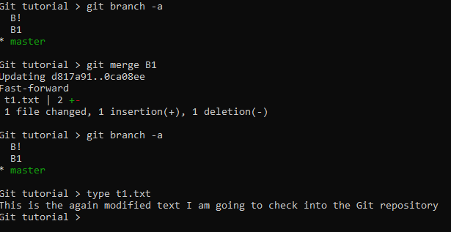
Working with branches
Merging a branch
Getting the changes of a branch into the master: git merge
Run git branch –a
Run git merge B1
Run git branch –a
Verify the content of t1.txt

Slide 32
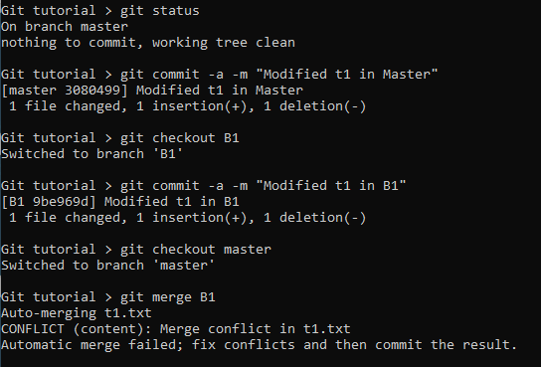
Working with branches
Merge conflicts
A conflict occurs if a file was modified in a branch and the master
Modify t1.txt ín the master branch and commit
Modify t1.txt ín the B1 branch and commit
Go back to the master branch
Run git merge B1

Slide 33

Working with branches
Resolving merge conflicts
The conflicts are shown in the file (in text files) and it is on the user to decide which version to use.
Once resolved the file needs saving and then the usual git add and git commit.

Slide 34
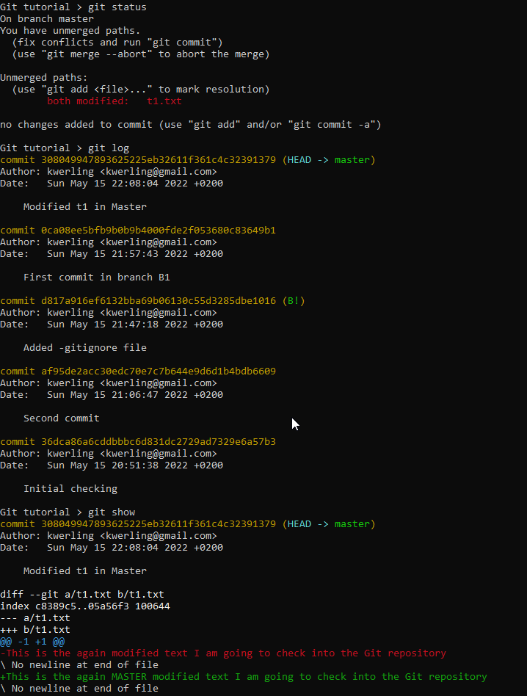
More info
Git show
The git show command provides more info than the git log: git show

Slide 35
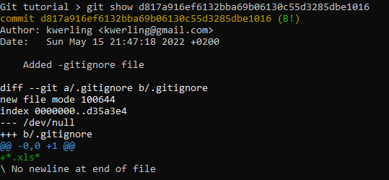
More info
Git show
Even more details per commit can be retrieved with git show <<hash of commit>>

